Slide 1
Track II
Advanced Distributed-Memory Programming
Day 1
2024 IHPCSS

Slide 2







Track 2 Team
Andrew Kirby Instructor
Research Scientist
School of Computing University of Wyoming

Slide 3
Track 2 Team
Ilya Zhukov Hands-On Helper
HPC Application Analyst Jülich Supercomputing Centre

Slide 4
Track 2 Team
John Cazes Hands-On Helper
Director of HPC Group Texas Advanced Computing Center

Slide 5
Track 2 Team
Sameer Deshmukh Hands-On Helper
Researcher Fujistu

Slide 6
Track 2 Team
Ramses van Zon Session Chair, Day 1
Training Lead SciNet, University of Toronto, Canada

Slide 7
Track 2 Team
Matthais Brust Session Chair, Day 2
Research Associate University of Luxembourg

Slide 8
Track 2 Team
Julie Wernert Evaluator
Lead Cyberinfrastructure and Evaluation Indiana University

Slide 9


Lecture Content Inspiration
Ludovic Capelli
David Henty
EPCC Archer Tutorials SC17 MPI Tutorial
https://web.cels.anl.gov/~thakur/sc17-mpi-tutorial/

Slide 10
Track Overview
Motivation

Slide 11
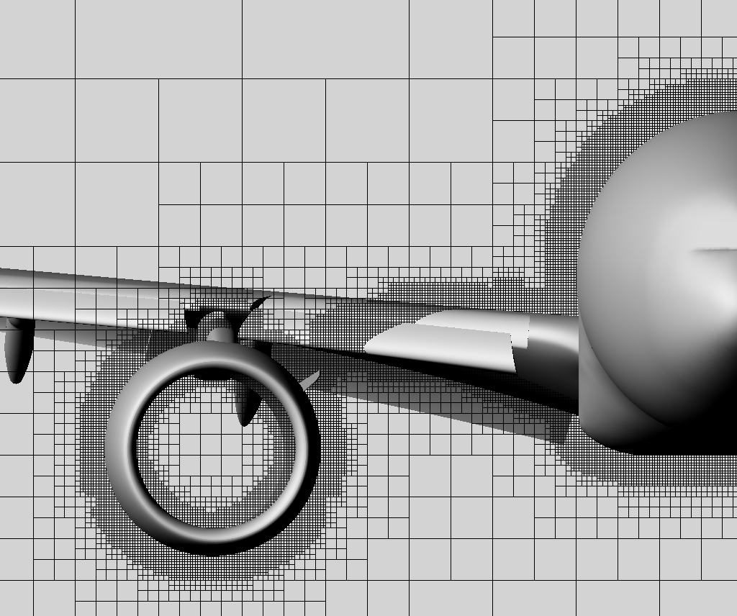
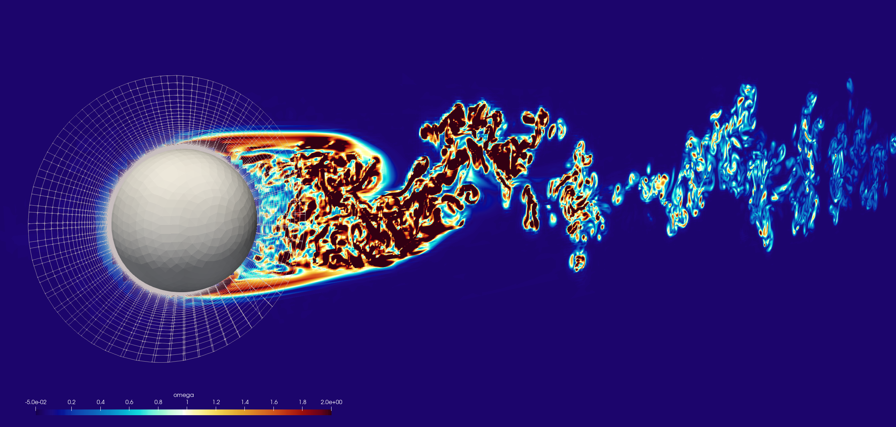
Motivation
Mesh-Based
Applications

Slide 12

Computational Fluid Dynamics

Slide 13


Computational Fluid Dynamics

Slide 14
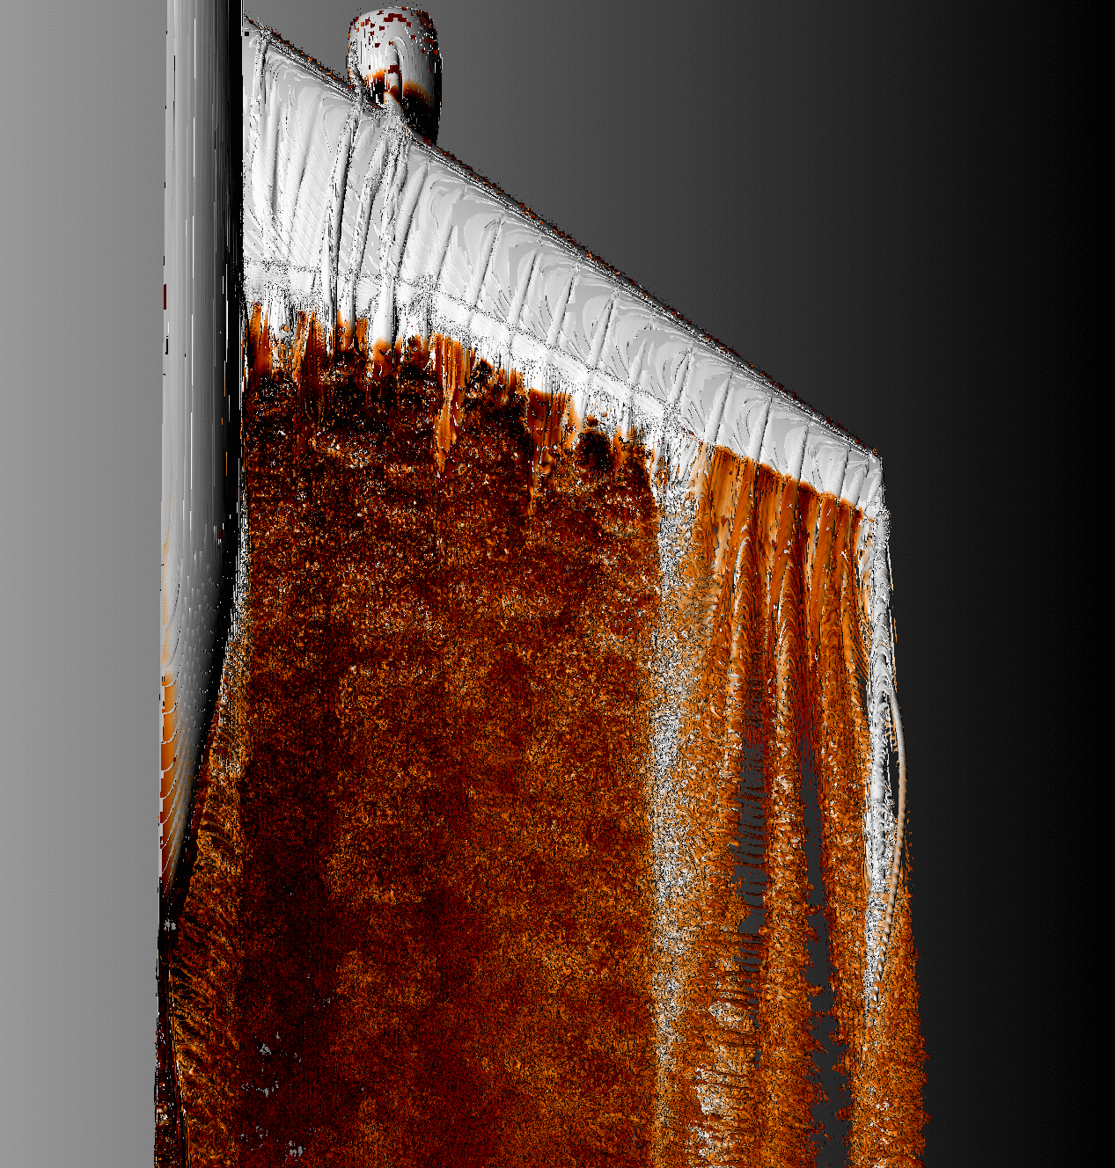
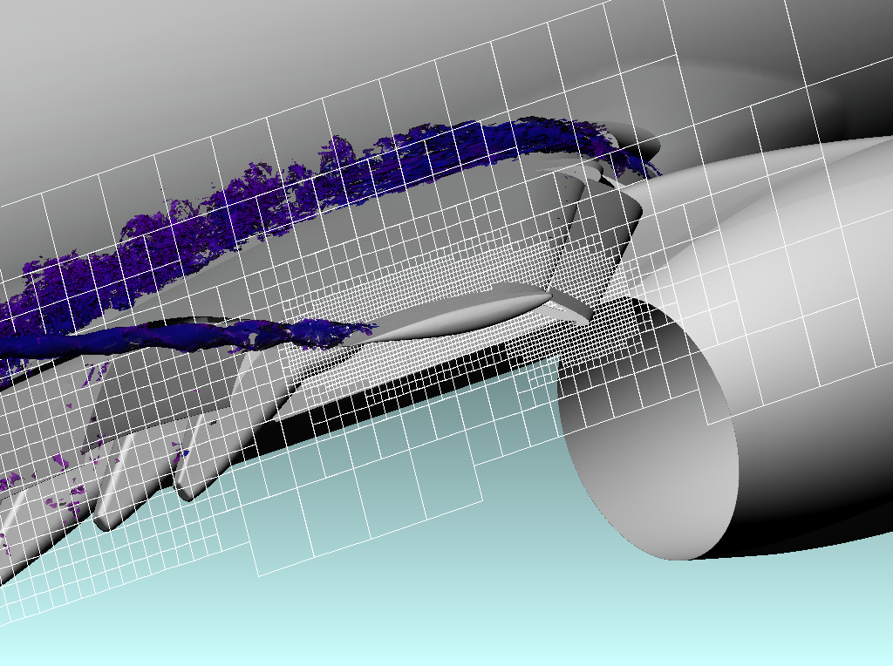

Variable Data Sizes
290 Million Pts
3rd Order – 27 pts
4th Order – 64 pts
6th Order – 216 pts
14

Slide 15
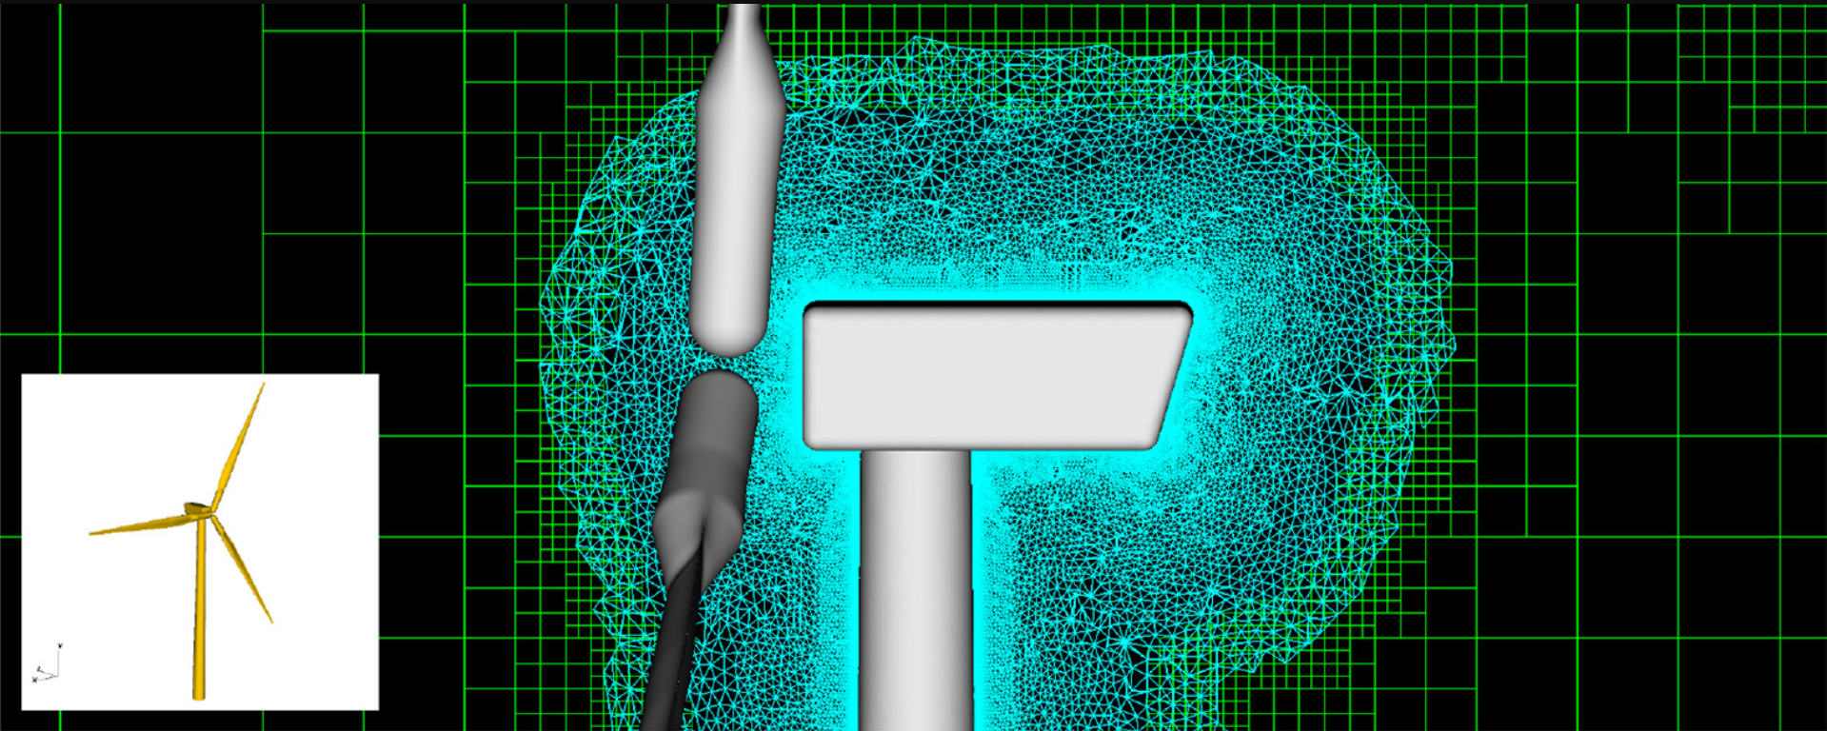
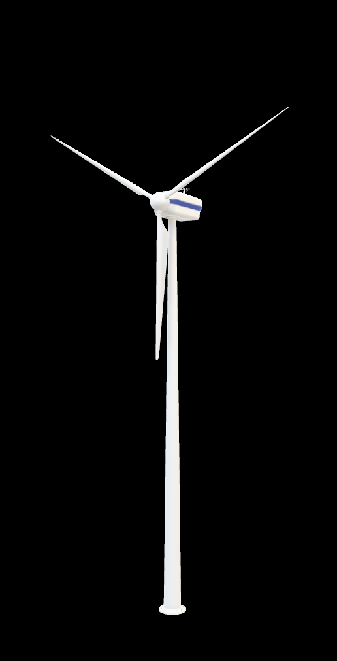
Nonuniform Meshes / MPI SUBGROUPS
M P I
M P I
M P I
M P I
M P I
DG4EST
NSU3D

Slide 16
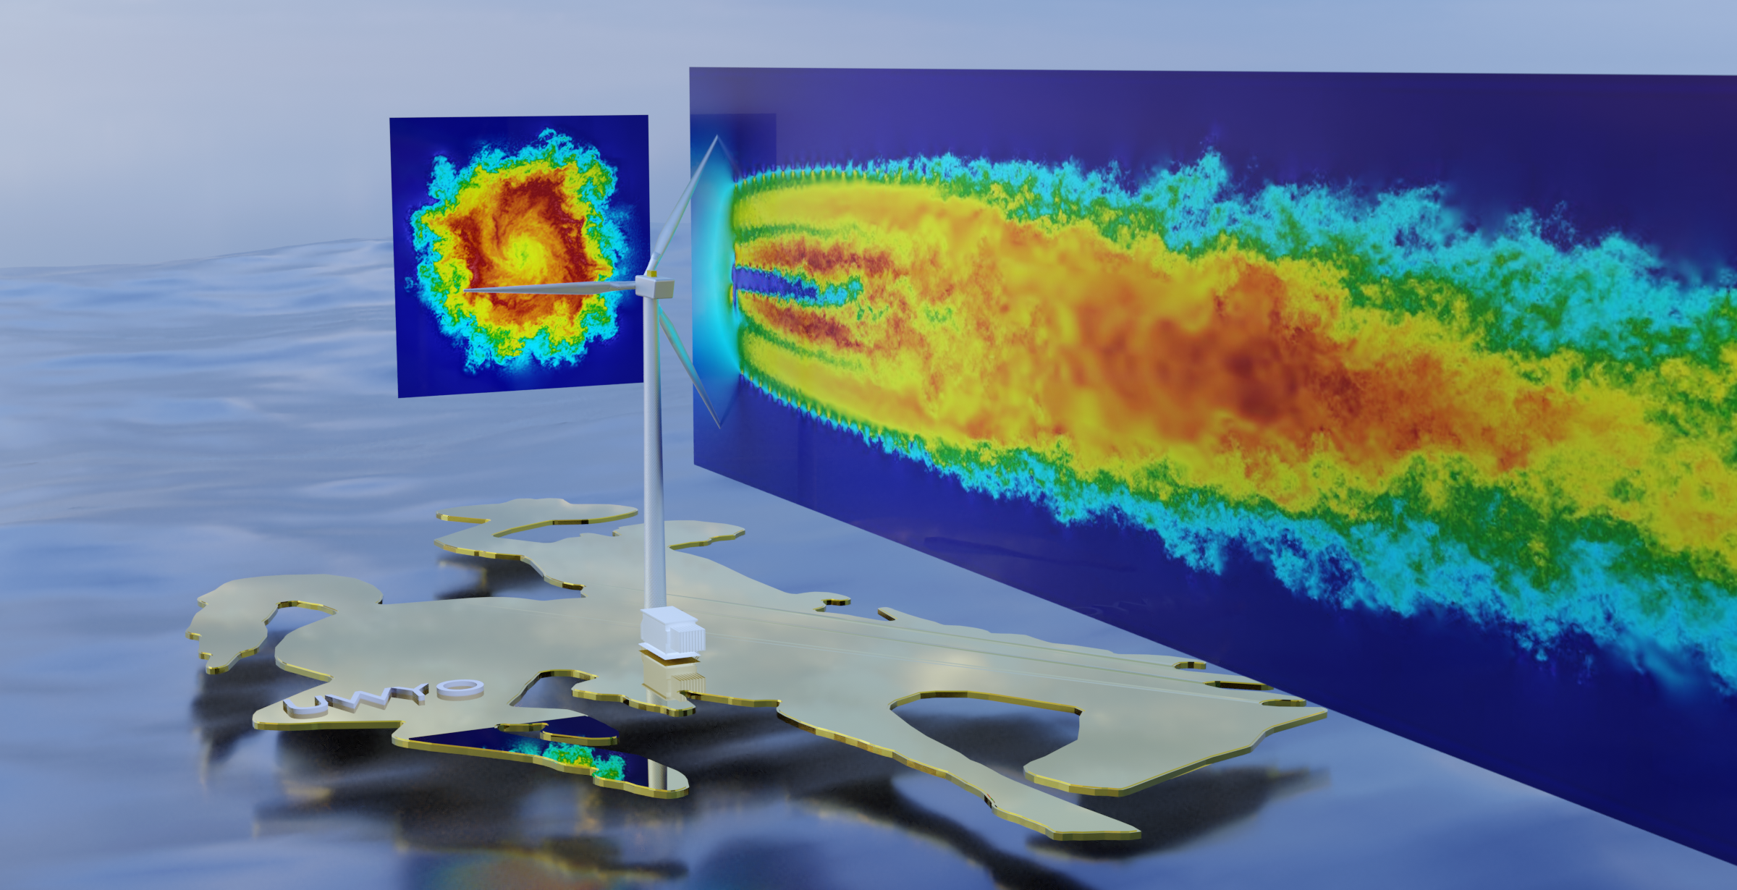
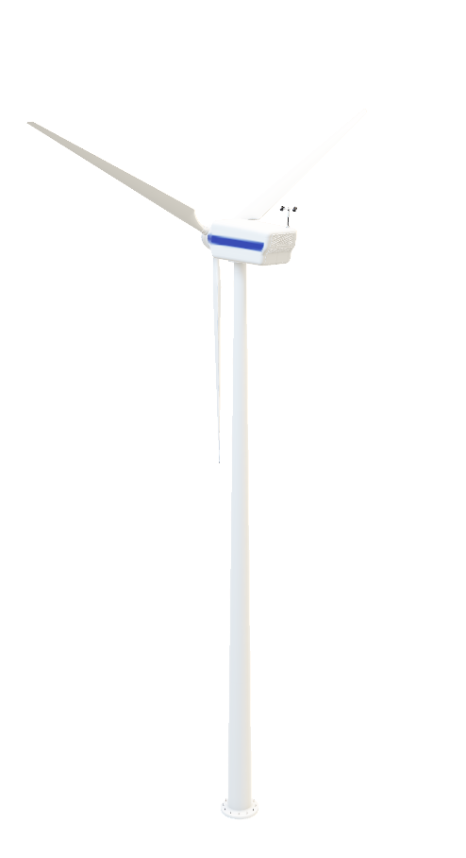
M P I
M P I
M P I
M P I

Slide 17

Track overview
M P I
Section I – Derived Datatypes & Ops
Section II – Cartesian Virtual Topologies
Section III – Graph Virtual Topologies
Section IV – Neighborhood Collectives
Section V – Graph Partitioning
M P I
M P I
M P I
M P I

Slide 18

Day 1 Agenda
Section I – Derived Datatypes & Ops
Hands On Activity # 1
Coffee Break (15:30-16:00)
Section II – Cartesian Virtual Topologies
Hands On Activity # 2

Slide 19
Section I
Datatypes & Ops

Slide 20


Brief REview
Distributed-Memory Parallel Computing
mpirun –np 4 ./myApp <args>
M P I
M P I
int x;
int y;
M P I
M P I
M P I

Slide 21







Brief REview
Distributed-Memory Parallel Computing
mpirun –np 4 ./myApp <args>
int x;
int y;
int x;
int y;
int x;
int y;
int x;
int y;
int x;
int y;
myApp
myApp
myApp
myApp
0
Rank
Rank
Rank
Rank

Slide 22
Brief REview
Distributed-Memory Parallel Computing
X = 0;
int x;
int y;
int x;
int y;
X = 0;
>> x = 0;
>> x = 0;
if(rank==0) x = 1;
if(rank==0) x = 1;
>> x = 1;
myApp
myApp
>> x = 0;
0
Rank
Rank

Slide 23
Brief REview
Distributed-Memory Parallel Computing
x
>> x = 1;
>> x = 0;
if(rank==0) MPI_Send(X,1) if(rank==1) MPI_Recv(X,0)
int x;
int y;
int x;
int y;
if(rank==0) MPI_Send(X,1) if(rank==1) MPI_Recv(X,0)
>> x = 1;
myApp
myApp
>> x = 1;
0
Rank
Rank

Slide 24






MPI Send/ReCv
int MPI_Send(const void *sbuf,
int count,
MPI_Datatype datatype,
int dest,
int tag,
MPI_Comm comm);
// [in] Initial address of send buffer
// [in] Maximum number of elements to send
// [in] Datatype of each send buffer entry
// [in] Rank of destination (integer)
// [in] Message tag (integer)
// [in] Communicator (handle)
Rank
int MPI_Recv(void *rbuf,
int count,
MPI_Datatype datatype,
int source,
int tag,
MPI_Comm comm,
MPI_Status *status);
// [out] Initial address of receive buffer
// [in] Maximum number of elements to recv
// [in] Datatype of each recv buffer entry
// [in] Rank of source (integer)
// [in] Message tag (integer)
// [in] Communicator (handle)
// [out] Status object (status)
Rank

Slide 25
MPI Intrinsic DATA TYPES
C/C++ |  | FORTRAN
MPI_CHAR MPI_WCHAR MPI_SHORT MPI_INT MPI_LONG MPI_LONG_LONG_INT MPI_LONG_LONG MPI_SIGNED_CHAR MPI_UNSIGNED_CHAR MPI_UNSIGNED_SHORT MPI_UNSIGNED_LONG MPI_UNSIGNED MPI_FLOAT MPI_DOUBLE MPI_LONG_DOUBLE | MPI_C_COMPLEX MPI_C_FLOAT_COMPLEX MPI_C_DOUBLE_COMPLEX MPI_C_LONG_DOUBLE_COMPLEX MPI_C_BOOL MPI_LOGICAL MPI_C_LONG_DOUBLE_COMPLEX MPI_INT8_T MPI_INT16_T MPI_INT32_T MPI_INT64_T MPI_UINT8_T MPI_UINT16_T MPI_UINT32_T MPI_UINT64_T MPI_BYTE MPI_PACKED | MPI_CHARACTER MPI_INTEGER MPI_INTEGER1 MPI_INTEGER2 MPI_INTEGER4 MPI_REAL MPI_REAL2 MPI_REAL4 MPI_REAL8 MPI_DOUBLE_PRECISION MPI_COMPLEX MPI_DOUBLE_COMPLEX MPI_LOGICAL MPI_BYTE MPI_PACKED
25

Slide 26
MPI DATA TYPES
Recall : MPI just gets the starting
address of the memory you want to send/receive.
i.e.,
MPI_Send (const void *sbuf, … ) MPI_Recv ( void *rbuf, … )
What happens if we want
to send custom data
without making a copy?
MPI_Recv(void *rbuf,
int count,
MPI_Datatype datatype,
int source,
int tag,
MPI_Comm comm,
MPI_Status *status);
MPI_Send(const void *sbuf,
int count,
MPI_Datatype datatype,
int dest,
int tag,
MPI_Comm comm);

Slide 27

MPI DATA TYPES
We can serialize custom data into a message stream
>> Declarative specification of data layout <<
Derived Data Types
Contiguous
Vector
Indexed
Struct
contig
contig
contig
vector
indexed
struct

Slide 28
MPI Derived DATA TYPES
MPI_Type_contiguous
MPI_Type_vector
MPI_Type_create_hvector
MPI_Type_indexed
MPI_Type_create_indexed_block
MPI_Type_create_subarray
MPI_Type_create_darray
MPI_Type_create_struct
> contiguous datatype (no gaps)
> regularly spaced datatype (gaps)
> like vector, but stride is specified in bytes
> variably-spaced datatype
> special case of indexed
> subarray within a
multidimensional array
> distribution of a ndim-array into
a grid of ndim-logical processes
> fully general datatype
Discussed in Parallel I/O Session (Wednesday)

Slide 29
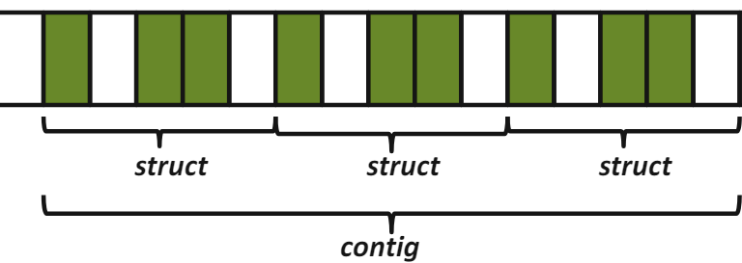
MPI_Type_contiguous
Creates a contiguous datatype.
int MPI_Type_contiguous(
int count,
MPI_Datatype oldtype,
MPI_Datatype *newtype);
count : Number of entries.
oldtype : Old datatype (handle).
newtype : New datatype (handle).

Slide 30
MPI_Type_contiguous Example
float A[4][4]
Creates a contiguous datatype.
int MPI_Type_contiguous(
int count,
MPI_Datatype oldtype,
MPI_Datatype *newtype);
1.0 | 2.0 | 3.0 | 4.0
5.0 | 6.0 | 7.0 | 8.0
9.0 | 10.0 | 11.0 | 12.0
13.0 | 14.0 | 15.0 | 16.0
MPI_Datatype row_type;
int MPI_Type_contiguous(
4, // count
MPI_FLOAT, // old type
&row_type); // new type
MPI_Type_commit(&row_type);
MPI_Send(&A[2][0],
1, row_type,
dest, tag, comm);
30

Slide 31
MPI_Type_vector
Creates a vector (strided) datatype.
int MPI_Type_vector(
int count,
int blocklen,
int stride,
MPI_Datatype oldtype,
MPI_Datatype *newtype);
How can we send the subarray?

Slide 32
MPI_Type_vector
Creates a vector (strided) datatype.
int MPI_Type_vector(
int count,
int blocklen,
int stride,
MPI_Datatype oldtype,
MPI_Datatype *newtype);
How can we send the subarray?

Slide 33
MPI_Type_vector Example.1
Creates a vector (strided) datatype.
int MPI_Type_vector(
int count,
int blocklen,
int stride,
MPI_Datatype oldtype,
MPI_Datatype *newtype);
count : Number of blocks.
> “How many chunks of data?”
blocklens : Number of elements in each block.
> “How many things in a chunk?”
stride : Number of elements between start of each block.
> “How many units (of things) between chunks?
oldtype : Old datatype (handle).
newtype : New datatype (handle).
blocklen = 3
count = 2
stride = 5

Slide 34
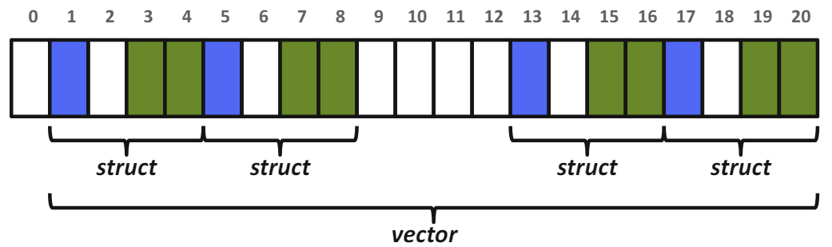
MPI_Type_vector Example.2
Creates a vector (strided) datatype.
int MPI_Type_vector(
int count,
int blocklen,
int stride,
MPI_Datatype oldtype,
MPI_Datatype *newtype);
count : Number of blocks.
> “How many chunks of data?”
blocklens : Number of elements in each block.
> “How many things in a chunk?”
stride : Number of elements between start of each block.
> “How many units (of things) between chunks?
oldtype : Old datatype (handle).
newtype : New datatype (handle).

Slide 35
MPI_Type_vector Example.3
bx
int MPI_Type_vector(
int count,
int blocklen,
int stride,
MPI_Datatype oldtype,
MPI_Datatype *newtype);
MPI_Datatype HALO_Y_DIR_TYPE;
int MPI_Type_vector(
by, // count
1, // blocklen
bx+2, // stride
MPI_DOUBLE, // old type
&HALO_Y_DIR_TYPE);// new type
by

Slide 36
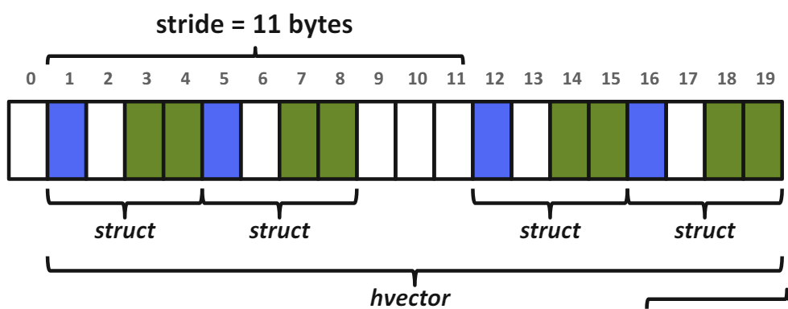
MPI_Type_create_hvector (MPI_Type_hvector deprecated)
Creates a vector (strided) data type with offset in bytes.
int MPI_Type_create_hvector(
int count,
int blocklen,
MPI_Aint stride,
MPI_Datatype oldtype,
MPI_Datatype *newtype);
count : Number of blocks.
blocklens : Number of elements in each block.
stride : Number of bytes between start of each block.
oldtype : Old datatype (handle).
newtype : New datatype (handle).

Slide 37
MPI_Type_create_hvector Example
bx
int MPI_Type_create_hvector(
int count,
int blocklen,
MPI_Aint stride,
MPI_Datatype oldtype,
MPI_Datatype *newtype);
MPI_Datatype HALO_Y_DIR_HTYPE;
int MPI_Type_create_hvector(
by, // count
1, // blocklen
(bx+2)*sizeof(double), // byte stride
MPI_DOUBLE, // old type
&HALO_Y_DIR_HTYPE);// new type
by

Slide 38
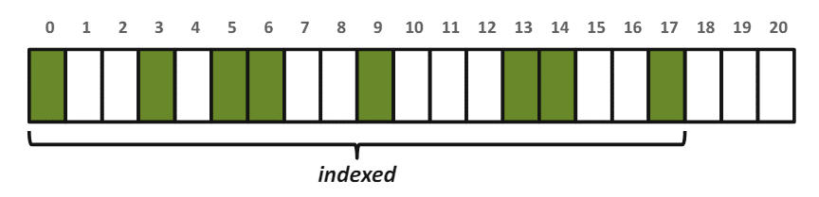
MPI_Type_Indexed
Creates an indexed datatype.
int MPI_Type_indexed(
int count,
int *array_of_blocklens,
int *array_of_displacements,
MPI_Datatype oldtype,
MPI_Datatype *newtype);
count : Length of array of displacements.
array_of_blocklens :
Size of each block (ints).
array_of_displacements : Array of displacements (ints).
In units of extent of oldtype.
oldtype : Old datatype (handle).
newtype : New datatype (handle).

Slide 39
MPI_Type_Indexed Example
int blocklens[6] = {1,1,2,1,2,1};
int displace[6] = {0,3,5,9,13,17};
int MPI_Type_indexed(6,
blocklens,
displace,
MPI_DOUBLE,
&new_index_type);
count : Number of data blocks.
array_of_blocklens :
Size of each block (ints).
array_of_displacements : Array of displacements (ints).
In units of extent of oldtype.
oldtype : Old datatype (handle).
newtype : New datatype (handle).

Slide 40
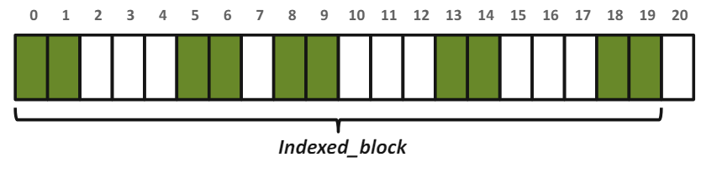
MPI_Type_create_Indexed_block
Creates an indexed data type with the same block length for all blocks.
int MPI_Type_create_indexed_block(
int count,
int blocklen,
int *array_of_displacements,
MPI_Datatype oldtype,
MPI_Datatype *newtype);
count : Length of array of displacements.
blocklen : Size of block (int).
array_of_displacements : Array of displacements (ints).
In units of extent of oldtype.
oldtype : Old datatype (handle).
newtype : New datatype (handle).

Slide 41
MPI_Type_create_Indexed_block Example
int displacement[5] = {0,5,8,13,18};
int MPI_Type_create_indexed_block(
5,
2,
displacement,
MPI_DOUBLE,
&new_indexed_block_type);
count : Length of array of displacements.
blocklen : Size of block (int).
array_of_displacements : Array of displacements (ints).
In units of extent of oldtype.
oldtype : Old datatype (handle).
newtype : New datatype (handle).

Slide 42
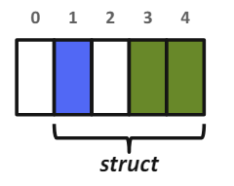
MPI_Type_CREATE_STRUCT
Creates a structured data type.
int MPI_Type_create_struct(
int count,
int *array_of_blocklens,
MPI_Aint *array_of_displacements,
MPI_Datatype *array_of_types,
MPI_Datatype *newtype);
count : Number of blocks (type entries).
array_of_blocklens :
Array of block lengths.
array_of_displacements :
Array of byte displacements.
array_of_types : Array of old datatypes.
newtype : New datatype (handle).
typedef struct {
int id;
char flag;
float x, y;
} data_struct;

Slide 43
MPI_Type_extent
For creating struct datatypes, we need
need byte displacements/offsets
MPI_Type_extent (not safe!)
struct {
float x, y, z, velocity;
int n, type;
} Particle;
Particle particles[NELEM];
MPI_Type_extent(MPI_FLOAT, &extent);
count = 2;
blockcounts[0] = 4; blockcount[1] = 2;
oldtypes[0] = MPI_FLOAT; oldtypes[1] = MPI_INT;
displ[0] = 0; displ[1] = 4*extent;
int MPI_Type_create_struct(
int count,
int *array_of_blocklens,
MPI_Aint *array_of_displacements,
MPI_Datatype *array_of_types,
MPI_Datatype *newtype);
… … …
f | f | f | f | i | i
f | f | f | f | i | i
particles[NELEM];

Slide 44
Mind the alignments!
C struct may be automatically padded by the compiler!
struct {
char a;
char gap0[3];
int b;
char c;
char gap1[3];
} x;
struct {
char a;
int b;
char c;
} x;

Slide 45
MPI_Get_address
Good for handling inner padding issue…
But does not account for trailing struct padding
Important when sending more than one struct
struct {
float x, y, z, velocity;
int n, type;
} Particle;
Particle particles[NELEM];
MPI_Get_address(&Particle, &base);
MPI_Get_address(&Particle.x, &F_offset);
MPI_Get_address(&Particle.n, &I_offset);
count = 2;
blockcounts[0] = 4; blockcount[1] = 2;
oldtypes[0] = MPI_FLOAT; oldtypes[1] = MPI_INT;
displ[0] = F_offset - base; displ[1] = I_offset - base;
int MPI_Type_create_struct(
int count,
int *array_of_blocklens,
MPI_Aint *array_of_displacements,
MPI_Datatype *array_of_types,
MPI_Datatype *newtype);
… … …
f | f | f | f | i | i
f | f | f | f | i | i
particles[NELEM];

Slide 46
MPI_TYPE_CREATE_RESIZED
Returns a new data type with new extent and upper and lower bounds.
int MPI_Type_create_resized(
MPI_Datatype oldtype,
MPI_Aint lwrbnd,
MPI_Aint extent,
MPI_Datatype *newtype);
oldtype : Input data type (handle).
lwrbnd : New lower bound of data type (# of bytes).
extent : New extent of data type (# of bytes).
newtype : New datatype (handle).
Returns new datatype that is identical to oldtype,
except the lower bound of this new datatype is set to be “lb”,
and its upper bound is set to be “lb + extent”.

Slide 47
MPI_TYPE_CREATE_RESIZED Example
/* Sending an array of structs portably */
struct PartStruct particle[100];
MPI_Datatype ParticleType;
/* check if extent is correct */
MPI_Type_get_extent(ParticleType, &lb, &extent);
if (extent != sizeof(particle[0])) {
MPI_Datatype old = ParticleType;
MPI_Type_create_resized(old, // [in] old datatype
0, // [in] new lower bound byte offset
sizeof(particle[0]), // [in] new byte extent of data type
&ParticleType); // [out] new datatype
MPI_Type_free(&old);
}
MPI_Type_commit(&ParticleType);

Slide 48
MPI_Type_CREATE_STRUCT, Revisited Example
data_struct Data;
MPI_Aint base, member_offset;
MPI_Aint offsets[3];
int blockcounts[3];
MPI_Datatype oldtypes[3];
// compute base address in struct
MPI_Get_address(&Data, &base);
// description of the 1 MPI_INT field: id
MPI_Get_address(&Data.id, &member_offset);
offsets[0] = member_offset - base;
blockcounts[0] = 1;
oldtypes[0] = MPI_INT;
// description of the 1 MPI_CHAR field: flag
MPI_Get_address(&Data.flag, &member_offset);
offsets[1] = member_offset - base;
blockcounts[1] = 1;
oldtypes[1] = MPI_CHAR;
// description of the 2 MPI_FLOAT fields: x,y
MPI_Get_address(&Data.x, &member_offset);
offsets[2] = member_offset - base;
blockcounts[2] = 2;
oldtypes[2] = MPI_FLOAT;
MPI_Datatype new_struct_type;
int MPI_Type_create_struct(
3, // # of blocks
blockcounts, // # of elements in each block
offsets, // Byte displacements of each block
oldtypes, // Type of elements in each block
&new_struct_type); // New data type
// check if extent is correct of new_struct_type
MPI_Type_get_extent(new_struct_type, &lb, &extent);
...
typedef struct {
int id;
char flag;
float x, y;
} data_struct;

Slide 49
MPI_Type_Commit / Free / Dup
Types must be committed before use!
Only the DDT’s that are used
MPI_Type_commit may perform extensive optimizations
Types should be deleted when finished
Free up MPI resources
Does not affect types constructed from it
Types may be duplicated
May be useful for holding state of type before modification
MPI_Datatype ParticleType;
// Build DDT ...
MPI_Type_commit(&ParticleType);
MPI_Type_free(&ParticleType);
MPI_Datatype ParticleTypeDuplicate;
MPI_Type_dup(ParticleType,
&ParticleTypeDuplicate);

Slide 50
MPI_Op_Create
Creates a user-defined combination function handle.
int MPI_Op_create(
MPI_User_function *function,
int commute,
MPI_Op *op);
function : User-defined function.
commute : True if commutative; false otherwise.
op : Custom operation (handle).
MPI_Op op;
MPI_Datatype ctype;
mpiret = MPI_Type_contiguous(7, MPI_DOUBLE, &ctype); mpiret = MPI_Type_commit(&ctype);
mpiret = MPI_Op_create((MPI_User_function *) stats_mpifunc, 1, &op);
mpiret = MPI_Allreduce(flatin, flatout, nvars, ctype, op, mpicomm);

Slide 51
MPI_Op_Create
Creates a user-defined combination function handle.
int MPI_Op_create(
MPI_User_function *function,
int commute,
MPI_Op *op);
function : User-defined function.
commute : True if commutative; false otherwise.
op : Custom operation (handle).
mpiret = MPI_Op_create((MPI_User_function *) stats_mpifunc, 1, &op);
mpiret = MPI_Allreduce(flatin, flatout, nvars, ctype, op, mpicomm);
typedef void MPI_User_function(void *invec,
void *inoutvec,
int *len,
MPI_Datatype *datatype);

Slide 52
MPI_Op_Create Example
// Define Custom Collective Function
void accumulate_values_func(void *invec,
void *inoutvec, int *len,
MPI_Datatype *datatype){
const int IX=0, IY=1, IZ=2, NINDEX=3;
double *in = (double *) invec;
double *inout = (double *) inoutvec;
/* sum values */ for (int i = 0; i < *len; ++i) {
inout[IX] += in[IX];
inout[IY] += in[IY];
inout[IZ] += in[IZ];
/* advance to next data set */
in += NINDEX;
inout += NINDEX;
}
}
// Construct MPI Type & Op
MPI_Op op;
MPI_Datatype ctype;
double values[3*npoints]; // TODO: init
double value_sums[3*npoints]; // TODO: zero
/* create contiguous type & commit */
MPI_Type_contiguous(3, // stack 3 doubles
MPI_DOUBLE, &ctype);
MPI_Type_commit(&ctype);
/* create MPI Op & perform Allreduce */ MPI_Op_create( (MPI_User_function *) accumulate_values_func, 1, // commutative operation &op); // [out] MPI Op (handle)
MPI_Allreduce(values, value_sums, npoints, ctype, op, comm);

Slide 53
DDT Review: Selection order
Simple and effective performance model
More parameters == slower performance
predefined < contig < vector < indexed_block < index < struct
Advice to developers
Construct datatypes hierarchically bottom-up

Slide 54
Hands On Activity #1
20 Minutes
1.0 | 2.0 | 3.0 | 4.0
5.0 | 6.0 | 7.0 | 8.0
9.0 | 10.0 | 11.0 | 12.0
13.0 | 14.0 | 15.0 | 16.0
MPI_Type_contiguous
MPI_Type_vector
MPI_Type_indexed
MPI_Type_create_struct

Slide 55
Section II
Cartesian Virtual Topologies

Slide 56
Structured Meshes
Typical Communication Pattern
4 Neighbors
A structured mesh is a mesh where one can find a connectivity pattern that applies to every element in the mesh.

Slide 57
Structured Meshes
Typical Communication Pattern
6 Neighbors
A structured mesh is a mesh where one can find a connectivity pattern that applies to every element in the mesh.

Slide 58
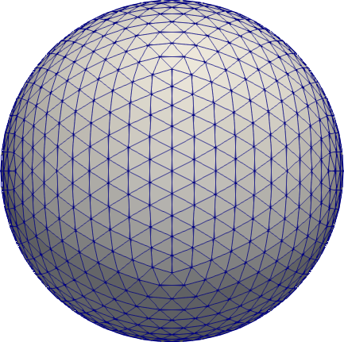

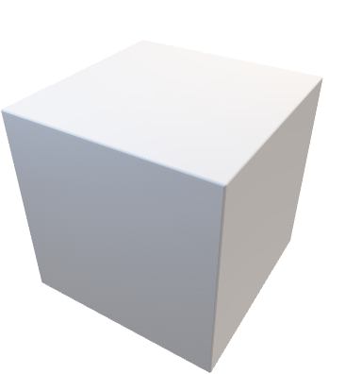


Structured Meshes
Hexahedrons
Tetrahedrons
Pyramids
Dodecahedrons

Slide 59
Load Balancing
Basic Partitioning
Load balancing a structured mesh typically comes down to partitioning the mesh to have an equal number of elements per Processing Element (PE).
Partition 0
Partition 1
Partition 2
Partition 3

Slide 60
Load Balancing
Basic Partitioning
Load balancing a structured mesh typically comes down to partitioning the mesh to have an equal number of elements per Processing Element (PE).
Partition 0
Partition 1
Partition 2

Slide 61
Load Balancing: A little less Trivial
Basic Partitioning
Pros
No need to alter the underlying decomposition.
Cons
Load-imbalance present: 3 MPI processes have 9 elements, whereas 1 MPI process has 5 elements.
Partition 0
Partition 1
Partition 2
Partition 3

Slide 62
Load Balancing: A little less Trivial
Cyclic Partitioning
Pros
Every MPI process is assigned 8 elements.
Cons
Hindered data locality as elements are rarely consecutive.
Partition 0
Partition 1
Partition 2
Partition 3

Slide 63
Load Balancing: A little less Trivial
Advanced Partitioning
Pros
Every PE has an identical number of elements (8).
Most elements are consecutive
Cons
More complex.
Takes more time to complete.
Partition 0
Partition 1
Partition 2
Partition 3

Slide 64
Structured Meshes: Limitations
Pros
Structured meshes have interesting properties that make their storage in memory and indexing, among other aspects, convenient.
Cons
However, many real world meshes are more complex and do not decompose into a structured mesh.

Slide 65
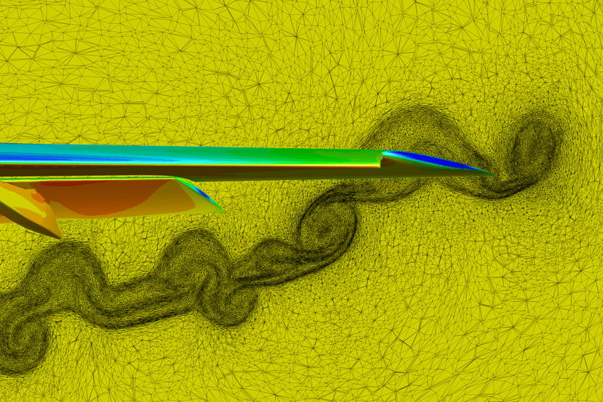
Unstructured Meshes
Partitioning octree unstructured meshes?
Partitioning adaptive meshes?
Partitioning fully unstructured meshes?
Source: NASA FUND3D

Slide 66
Partitioning:
Hard.
In general, user is responsible for partitioning!

Slide 67
Partitioning: Potential Options
MPI_Dims_create
Partitioning Cartesian meshes?
Morton-code orderings.
Partitioning octree unstructured meshes?
Advanced partitioning strategies exist. ParMETIS is a common solution (Sec. V).
Partitioning fully unstructured meshes?

Slide 68
ViRtual Topology: What? Why?
What is it?
A virtual topology is the arrangement of MPI processes.
Why is it useful?
Provide convenient and intuitive constructions, e.g., finding ranks with shifts in a Cartesian virtual topology.
Inform the MPI runtime of the communications patterns, which can be leveraged by the underlying runtime to improve the placement of MPI processes to hardware.
VirTops are not required (c.f.: do communications yourself), but
Simplifies writing of code.
68

Slide 69
ViRtual Topology: Factors to consider
MPI process contains one thread, which is eventually run by a hardware thread.
Certain hardware threads may be on the same core.
Certain caches may be shared by multiple cores (typically, L3).
Certain cores may belong to the same processor and thus access the same memory module(s) (c.f.: NUMA region).
Certain processors may be on different nodes.
Certain nodes may be on different racks.
Back to “Why is it useful?”
By declaring a virtual topology, the MPI runtime environment has extra information to leverage for a more efficient placement.
Better Performance
69

Slide 70
Virtual Topology: Cartesian
Goal: Make a new communicator with Cartesian topology information attached.
0
[0][0]
1
[0][1]
2
[0][2]
3
[0][3]
4
[1][0]
5
[1][1]
6
[1][2]
7
[1][3]
8
[2][0]
9
[2][1]
10
[2][2]
11
[2][3]
70

Slide 71
MPI_Cart_create
Makes a new communicator to which Cartesian topology information has been attached.
int MPI_Cart_create(
MPI_Comm comm_old,
int ndims,
const int dims[],
const int periods[], int reorder,
MPI_Comm *comm_cart);
comm_old : Input communicator.
ndims : Number of dimensions of Cartesian grid (>= 0).
dims : Array of size ndims specifying number of processes in each dimension.
periods : Array of size ndims specifying whether dim is periodic.
reorder : Rank reordering flag.
comm_cart : Output communicator with Cart topology.
71

Slide 72
MPI_Dims_create
Partitions Cartesian meshes.
Creates a division of processors in a Cartesian grid.
int MPI_Dims_create(
int nnodes,
int ndims,
int dims[]);
nnodes : Number of nodes in grid.
ndims : Number of Cartesian Topology dimensions.
dims : Array of size ndims specifying number of nodes in each dimension.
Nonzero values in dims sets the number of processes required in that direction.
WARNING: make sure dims is set to 0 before the call
dims before call | Function call | dims on return
(0, 0) | MPI_Dims_create (6, 2, dims); | (3, 2)
(0, 0) | MPI_Dims_create (7, 2, dims); | (7, 1)
(0, 3, 0) | MPI_Dims_create (6, 3, dims); | (2, 3, 1)
(0, 3, 0) | MPI_Dims_create (7, 3, dims); | Erroneous call
72

Slide 73
Virtual Topology: Cartesian Mapping Functions
MPI_Cart_rank - Determines process rank in communicator given Cartesian location.
int MPI_Cart_rank(
MPI_Comm comm_cart,
int coords[],
int *rank);
0
[0][0]
1
[0][1]
2
[0][2]
3
[0][3]
4
[1][0]
5
[1][1]
6
[1][2]
7
[1][3]
int coords[2] = {1,2};
MPI_Cart_rank(comm_cart,
coords,
&rank);
>> rank = 6
8
[2][0]
9
[2][1]
10
[2][2]
11
[2][3]
73

Slide 74
Virtual Topology: Cartesian Mapping Functions
MPI_Cart_coords - Determines process coords in Cartesian topology given rank in group.
int MPI_Cart_coords(
MPI_Comm comm_cart,
int rank,
int maxdims,
int coords[]);
0
[0][0]
1
[0][1]
2
[0][2]
3
[0][3]
4
[1][0]
5
[1][1]
6
[1][2]
7
[1][3]
int rank = 6, maxdims = 2;
MPI_Cart_coords(comm_cart,
rank, maxdims,
coords);
>> coords[] = {1,2}
8
[2][0]
9
[2][1]
10
[2][2]
11
[2][3]
74

Slide 75
Virtual Topology: Cartesian Mapping Functions
MPI_Cart_shift - Returns the shifted source and destination ranks, given a shift direction and amount.
int MPI_Cart_shift(
MPI_Comm comm_cart,
int direction,
int displacement,
int *rank_source, int *rank_dest);
0
[0][0]
1
[0][1]
2
[0][2]
3
[0][3]
4
[1][0]
5
[1][1]
6
[1][2]
7
[1][3]
[in] direction : Coordinate index of shift
[in] displacement : > 0: positive shift, < 0: negative shift
8
[2][0]
9
[2][1]
10
[2][2]
11
[2][3]
75

Slide 76

Virtual Topology: Cartesian Mapping Functions
MPI_Cart_shift - Returns the shifted source and destination ranks, given a shift direction and amount.
LEXICOGRAPHIC ORDERING
0
[0][0]
1
[0][1]
2
[0][2]
3
[0][3]
+X
4
[1][0]
5
[1][1]
6
[1][2]
7
[1][3]
+Y
[in] direction : Coordinate index of shift
[in] displacement : > 0: positive shift, < 0: negative shift
8
[2][0]
9
[2][1]
10
[2][2]
11
[2][3]
+Z
76

Slide 77
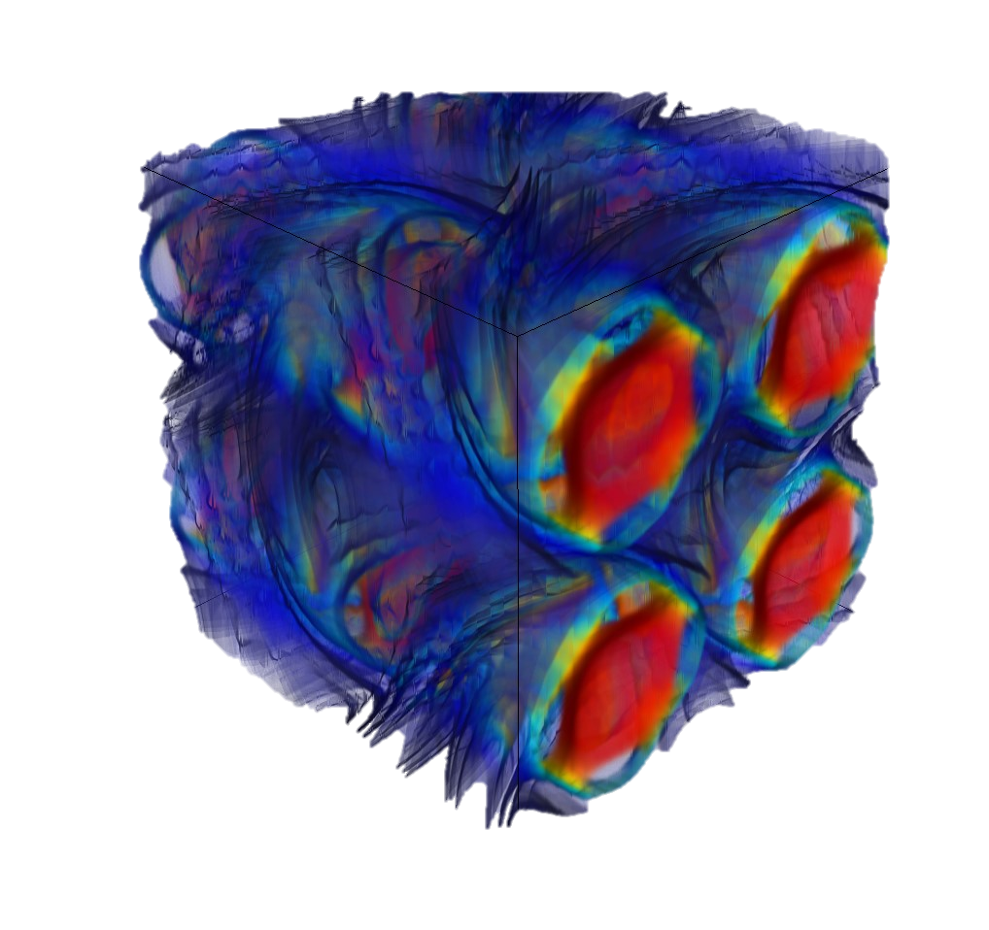
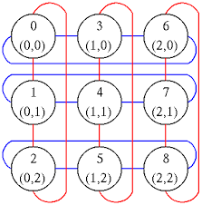
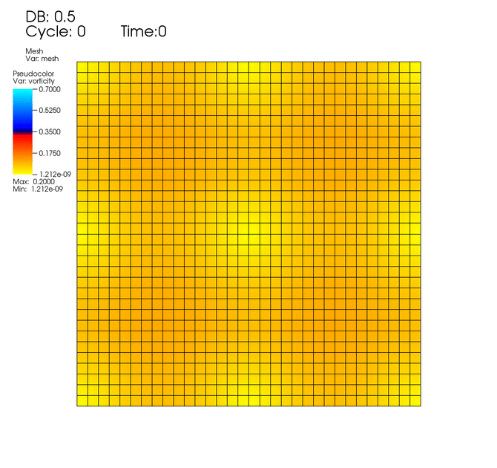
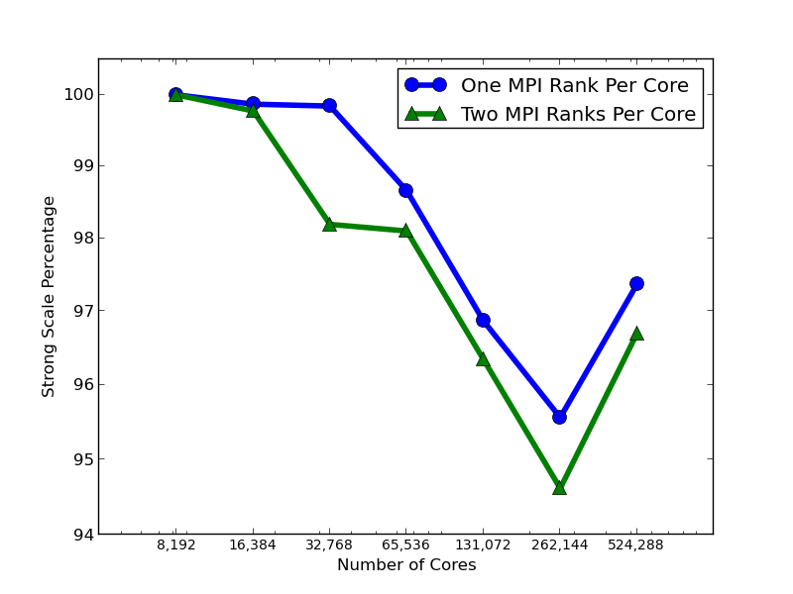

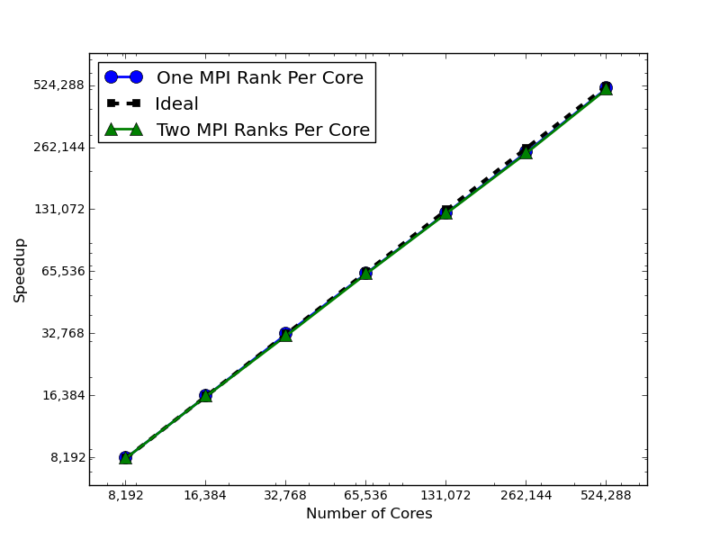
MPI_Cart_shift: Parallel Scaling
Strong Scaling on ALCF Mira
Taylor-Green Vortex
Fully periodic
Periodic Mesh: [512, 512, 512]
Discontinuous Galerkin: 5th -order
16.8 Billion DOFs
83.9 Billion unknowns
1 Million MPI Ranks

Slide 78

Hands On Activity #2
20 Minutes
MPI_Cart_shift

Slide 79
Track ii
Advanced Distributed-Memory Programming
Day 2
Andrew KirbY

Slide 80
Day 2 Agenda
Section III – Graph Virtual Topologies
Hands On Activity # 3
Coffee Break (10:30-11:00)
Section IV – Neighborhood Collectives
Hands On Activity # 4
Section V – Graph Partitioning
Hands On Activity # 5

Slide 81
Section III
Graph Topologies

Slide 82
Virtual Topology: Graphs
Goal: Make a new communicator with Graph Topology information attached.
0
1
1983
190
1160
2917
2215
3
5
2
4
840
2970
3667
6
7
82

Slide 83
Virtual Topology: Graphs
Three ways to create a graph topology:
MPI_Graph_create
MPI_Dist_graph_create
MPI_Dist_graph_create_adjacent
83

Slide 84
1. MPI_graph_create
Makes a new communicator to which topology information has been attached.
int MPI_Graph_create(
MPI_Comm comm_old,
int nnodes,
const int index[],
const int edges[],
int reorder,
MPI_Comm *comm_graph);
comm_old : Input communicator.
nnodes : Number of nodes in graph.
index : Array describing node degrees.
edges : Array describing graph
edges.
reorder : Rank reordering flag.
comm_graph : Output communicator with graph topology.
When creating a graph topology using MPI_Graph_create,
every MPI process pass the entirety of the graph topology.
84

Slide 85
1. MPI_graph_create
Makes a new communicator to which topology information has been attached.
0
2
0
2
0
2
0
2
1
3
1
3
1
3
1
3
MPI Process 0
MPI Process 1
MPI Process 2
MPI Process 3
When creating a graph topology using MPI_Graph_create,
every MPI process pass the entirety of the graph topology.
85

Slide 86
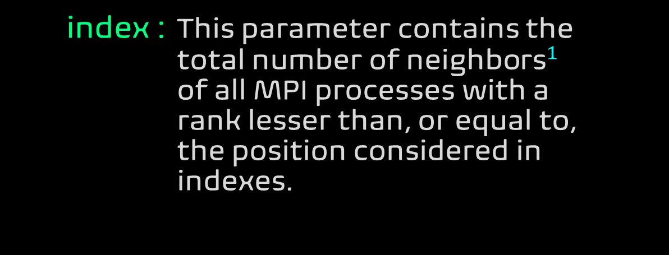
1. MPI_graph_create
Makes a new communicator to which topology information has been attached.
int MPI_Graph_create(
MPI_Comm comm_old,
int nnodes,
const int index[],
const int edges[],
int reorder,
MPI_Comm *comm_graph);
index : This parameter contains the total number of ${\text{neighbor}\text{s}}^{1}$ of all MPI processes with a rank lesser than, or equal to, the position considered in
indexes.
This design allows MPI to know the total number of entries in the edges parameter.
86

Slide 87
1. MPI_graph_create
Makes a new communicator to which topology information has been attached.
int MPI_Graph_create(
MPI_Comm comm_old,
int nnodes,
const int index[],
const int edges[],
int reorder,
MPI_Comm *comm_graph);
edges : This parameter contains all edges of the graph, sorted by the source identifier. Edges are undirected so you do not have to specify both edges for each connection. Redundant and self edges are also allowed.
87

Slide 88
1. MPI_graph_create Example
MPI Process | Connected To | Degree | Cumulated Degree
0 | 1, 2 | 2 | 2
1 | 3 | 1 | 3
2 | 1 | 1 | 4
3 | 1 | 1 | 5
4 | - | 0 | 5
5 | 5 | 1 | 6
0
1
3
5
2
4
This graph topology [using 7 MPI processes]:
* - Node connecting to a single neighbor (MPI process 1, 2, 3)
* - Node connecting to multiple neighbors (MPI process 0)
* - Node connected by a single neighbor (MPI processes 2, 3)
* - Node connected by multiple neighbors (MPI process 1)
* - Nodes forming a cycle (MPI processes 1 and 3, MPI process 5)
* - Node without neighbors (MPI process 4)
* - Node connected to itself (MPI Process 5)
* - MPI process not included at all in the graph (MPI process 6)
88

Slide 89
1. MPI_graph_create Example
MPI Process | Connected To | Degree | Cumulated Degree
0 | 1, 2 | 2 | 2
1 | 3 | 1 | 3
2 | 1 | 1 | 4
3 | 1 | 1 | 5
4 | - | 0 | 5
5 | 5 | 1 | 6
0
1
3
5
2
4
// Number of nodes in the graph (MPI process 4 not connected -> excluded)
const int number_of_nodes = 6;
// Declare the total number of neighbors until each MPI process (= the ones before + its own)
int indexes[6] = {2, 3, 4, 5, 5, 6}; // “inclusive scan”
// Declare the endpoint of each edge
int edges[6] = {1, 2, 3, 1, 1, 5};
89

Slide 90
1. MPI_graph_create Example
const int number_of_nodes = 6;
int indexes[6] = {2, 3, 4, 5, 5, 6};
int edges[6] = {1, 2, 3, 1, 1, 5};
int reorder = false;
// Create NEW communicator with graph topology.
MPI_Comm new_communicator;
MPI_Graph_create(MPI_COMM_WORLD,
number_of_nodes,
indexes,
edges,
reorder,
&new_communicator);
0
1
3
5
2
4
90

Slide 91
1. MPI_graph_create WARNING
Image a graph of with 100 billion edges
>> requires ~1 TB of RAM per MPI process <<
Every MPI process must store the entire graph.
Every MPI process passes the entire graph over the network
MPI_Graph_create is not scalable.
There is a better way!
91

Slide 92
2. MPI_Dist_graph_create
Makes a new communicator to which topology information has been attached.
0
2
1
3
0
2
0
0
3
1
3
MPI Process 0
MPI Process 1
MPI Process 2
MPI Process 3
Every MPI process may specify 0, 1 or more edges. The edges specified do not have to contain the MPI process that passes them.
92

Slide 93
2. MPI_Dist_graph_create
Makes a new communicator to which topology information has been attached.
int MPI_Dist_graph_create(
MPI_Comm comm_old,
int num_src_nodes,
const int sources[],
const int degrees[],
const int destinations[],
const int weights[],
MPI_Info info, int reorder,
MPI_Comm *comm_dist_graph);
num_src_nodes : Number of source nodes for which this process specifies edges.
sources : Array containing the num_src_nodes source nodes for which this process specifies edges (array of non-negative integers).
degrees : Array specifying the number of destinations for each source node in the source node array (array of non-negative integers).
93
* Note that the Process ID has nothing to do with the Node IDs.

Slide 94
2. MPI_Dist_graph_create
Makes a new communicator to which topology information has been attached.
int MPI_Dist_graph_create(
MPI_Comm comm_old,
int num_src_nodes,
const int sources[],
const int degrees[],
const int destinations[],
const int weights[],
MPI_Info info, int reorder,
MPI_Comm *comm_dist_graph);
destinations : Destination nodes for the source nodes in the source node array (array of non-negative integers).
weights : Weights for source to destination edges (array of non-negative integers).
info : Hints on optimization and interpretation of weights (handle).
reorder : Ranking may be reordered (true) or not (false) (logical).
94
* Note that the Process ID has nothing to do with the Node IDs.

Slide 95
2. MPI_Dist_graph_create Example
Makes a new communicator to which topology information has been attached.
int MPI_Dist_graph_create(
MPI_Comm comm_old,
int num_src_nodes,
const int sources[],
const int degrees[],
const int destinations[],
const int weights[],
MPI_Info info, int reorder,
MPI_Comm *comm_dist_graph);
0
1
2
3
4
5
95
* Note that the Process ID has nothing to do with the Node IDs.

Slide 96
2. MPI_Dist_graph_create Example
Makes a new communicator to which topology information has been attached.
int MPI_Dist_graph_create(
MPI_Comm comm_old,
int num_src_nodes,
const int sources[],
const int degrees[],
const int destinations[],
const int weights[],
MPI_Info info, int reorder,
MPI_Comm *comm_dist_graph);
Process 0*
num_src_nodes: 2
Sources[2]: {0, 1}
0
1
2
3
4
5
96
* Note that the Process ID has nothing to do with the Node IDs.

Slide 97
2. MPI_Dist_graph_create Example
Makes a new communicator to which topology information has been attached.
int MPI_Dist_graph_create(
MPI_Comm comm_old,
int num_src_nodes,
const int sources[],
const int degrees[],
const int destinations[],
const int weights[],
MPI_Info info, int reorder,
MPI_Comm *comm_dist_graph);
Process 0*
num_src_nodes: 2
Sources[2]: {0, 1}
Degrees[2]: {2,1}
0
1
2
3
4
5
97

Slide 98
2. MPI_Dist_graph_create Example
Makes a new communicator to which topology information has been attached.
int MPI_Dist_graph_create(
MPI_Comm comm_old,
int num_src_nodes,
const int sources[],
const int degrees[],
const int destinations[],
const int weights[],
MPI_Info info, int reorder,
MPI_Comm *comm_dist_graph);
Process 0*
num_src_nodes: 2
Sources[2]: {0, 1}
Degrees[2]: {2,1}
0
1
2
3
4
5
98
* Note that the Process ID has nothing to do with the Node IDs.

Slide 99
2. MPI_Dist_graph_create Example
Makes a new communicator to which topology information has been attached.
int MPI_Dist_graph_create(
MPI_Comm comm_old,
int num_src_nodes,
const int sources[],
const int degrees[],
const int destinations[],
const int weights[],
MPI_Info info, int reorder,
MPI_Comm *comm_dist_graph);
Process 0*
num_src_nodes: 2
Sources[2]: {0, 1}
Degrees[2]: {2,1}
Dest[2+1]: {3,1,4}
… Other processes then specify remaining edges.
0
1
2
3
4
5
99
* Note that the Process ID has nothing to do with the Node IDs.

Slide 100
2. MPI_Dist_graph_create
Allows MPI processes to pass any
edge of the graph, which offers the best flexibility.
>> Requires global communication <<
Slightly more expensive than next approach (adjacent).
100

Slide 101
3. MPI_Dist_graph_create_adjacent
Makes a new communicator to which topology information has been attached.
0
2
1
3
0
2
0
0
2
0
1
3
1
3
1
3
MPI Process 0
MPI Process 1
MPI Process 2
MPI Process 3
Each MPI process specifies all edges in which it is part of, and solely those edges.
Local Info Only
Direct Edges
Edges Specified Twice
101

Slide 102
3. MPI_Dist_graph_create_adjacent
Makes a new communicator to which topology information has been attached.
int MPI_Dist_graph_create_adjacent(
MPI_Comm comm_old,
int indegree,
const int sources[],
const int sourceweights[],
int outdegree,
const int destinations[],
const int destweights[],
MPI_Info info, int reorder,
MPI_Comm *comm_dist_graph);
indegree : Size of sources and sourceweights arrays.
sources : Ranks of processes for which the calling process is a destination (array of non-negative integers).
sourceweights : Weights of the edges into the calling process (array of non-negative integers).
102
* Note that the Process ID has nothing to do with the Node IDs.

Slide 103
3. MPI_Dist_graph_create_adjacent
Makes a new communicator to which topology information has been attached.
int MPI_Dist_graph_create_adjacent(
MPI_Comm comm_old,
int indegree,
const int sources[],
const int sourceweights[],
int outdegree,
const int destinations[],
const int destweights[],
MPI_Info info, int reorder,
MPI_Comm *comm_dist_graph);
outdegree : Size of destinations and destweights arrays.
destinations : Ranks of processes for which the calling process is a source (array of non-negative integers).
destweights : Weights of the edges out of the calling process (array of non-negative integers).
103
* Note that the Process ID has nothing to do with the Node IDs.

Slide 104
3. MPI_Dist_graph_create_adjacent Example
Makes a new communicator to which topology information has been attached.
int MPI_Dist_graph_create_adjacent(
MPI_Comm comm_old,
int indegree,
const int sources[],
const int sourceweights[],
int outdegree,
const int destinations[],
const int destweights[],
MPI_Info info, int reorder,
MPI_Comm *comm_dist_graph);
0
1
2
3
4
5
104

Slide 105
3. MPI_Dist_graph_create_adjacent Example
Makes a new communicator to which topology information has been attached.
int MPI_Dist_graph_create_adjacent(
MPI_Comm comm_old,
int indegree,
const int sources[],
const int sourceweights[],
int outdegree,
const int destinations[],
const int destweights[],
MPI_Info info, int reorder,
MPI_Comm *comm_dist_graph);
Process 0
0
1
2
3
4
5
105

Slide 106
3. MPI_Dist_graph_create_adjacent Example
Makes a new communicator to which topology information has been attached.
int MPI_Dist_graph_create_adjacent(
MPI_Comm comm_old,
int indegree,
const int sources[],
const int sourceweights[],
int outdegree,
const int destinations[],
const int destweights[],
MPI_Info info, int reorder,
MPI_Comm *comm_dist_graph);
Process 0
(map to Node 0) *
indegree: 0
outdegree: 2
0
1
2
3
4
5
106
* For convenience, map each Process to corresponding Graph Node.

Slide 107
3. MPI_Dist_graph_create_adjacent Example
Makes a new communicator to which topology information has been attached.
int MPI_Dist_graph_create_adjacent(
MPI_Comm comm_old,
int indegree,
const int sources[],
const int sourceweights[],
int outdegree,
const int destinations[],
const int destweights[],
MPI_Info info, int reorder,
MPI_Comm *comm_dist_graph);
Process 0
(map to Node 0) *
indegree: 0
outdegree: 2
dest[2]: {3, 1}
0
1
2
3
4
5
107
* For convenience, map each Process to corresponding Graph Node.

Slide 108
3. MPI_Dist_graph_create_adjacent Example
Makes a new communicator to which topology information has been attached.
int MPI_Dist_graph_create_adjacent(
MPI_Comm comm_old,
int indegree,
const int sources[],
const int sourceweights[],
int outdegree,
const int destinations[],
const int destweights[],
MPI_Info info, int reorder,
MPI_Comm *comm_dist_graph);
Process 0
(map to Node 0) *
indegree: 0
outdegree: 2
dest[2]: {3, 1}
0
1
2
3
4
5
108
* For convenience, map each Process to corresponding Graph Node.

Slide 109
3. MPI_Dist_graph_create_adjacent Example
Makes a new communicator to which topology information has been attached.
int MPI_Dist_graph_create_adjacent(
MPI_Comm comm_old,
int indegree,
const int sources[],
const int sourceweights[],
int outdegree,
const int destinations[],
const int destweights[],
MPI_Info info, int reorder,
MPI_Comm *comm_dist_graph);
Process 1
0
1
2
3
4
5
109
* For convenience, map each Process to corresponding Graph Node.

Slide 110
3. MPI_Dist_graph_create_adjacent Example
Makes a new communicator to which topology information has been attached.
int MPI_Dist_graph_create_adjacent(
MPI_Comm comm_old,
int indegree,
const int sources[],
const int sourceweights[],
int outdegree,
const int destinations[],
const int destweights[],
MPI_Info info, int reorder,
MPI_Comm *comm_dist_graph);
Process 1
(map to Node 1) *
0
1
2
3
4
5
110
* For convenience, map each Process to corresponding Graph Node.

Slide 111
3. MPI_Dist_graph_create_adjacent Example
Makes a new communicator to which topology information has been attached.
int MPI_Dist_graph_create_adjacent(
MPI_Comm comm_old,
int indegree,
const int sources[],
const int sourceweights[],
int outdegree,
const int destinations[],
const int destweights[],
MPI_Info info, int reorder,
MPI_Comm *comm_dist_graph);
Process 1
(map to Node 1) *
indegree: 3
Sources[3]: {4,0,2}
0
1
2
3
4
5
111
* For convenience, map each Process to corresponding Graph Node.

Slide 112
3. MPI_Dist_graph_create_adjacent Example
Makes a new communicator to which topology information has been attached.
int MPI_Dist_graph_create_adjacent(
MPI_Comm comm_old,
int indegree,
const int sources[],
const int sourceweights[],
int outdegree,
const int destinations[],
const int destweights[],
MPI_Info info, int reorder,
MPI_Comm *comm_dist_graph);
Process 1
(map to Node 1) *
indegree: 3
Sources[3]: {4,0,2}
outdegree: 2
Dest[2]: {3,4}
... Remaining Processes
0
1
2
3
4
5
112
* For convenience, map each Process to corresponding Graph Node.

Slide 113
Virtual Topology: Graphs Recap
We have three ways to create a graph topology:
MPI_Graph_create
MPI_Dist_graph_create
MPI_Dist_graph_create_adjacent
Opportunities to Optimize Performance through Reordering Ranks
113

Slide 114
ViRtual Topology: Mapping Basics
MPI supports rank reordering.
Change numbering in a given allocation to reduce congestion or dilation.
Through may depends on vendor implementation, e.g., OpenMPI, MPICH, Intel MPI.
Example: On-Node Reordering
Naïve Map
Optimized Map
node 0
node 2
node 0
node 2
0
4
0
5
0
1
2215
2405
1983
190
1160
2917
2215
1
5
3
6
3
5
2
4
190
840
3134
6637
3667
840
2970
node 1
node 3
node 1
node 3
6
7
2
6
1
4
840
2917
3
7
2
7
114

Slide 115
Distributed Graph Neighbor Queries
MPI_Dist_graph_neighbors_count(MPI_Comm comm,int *indegree,int *outdegree,int *weighted);
Returns the number of in and out edges for the calling processes in a distributed graph topology and a flag indicating whether the distributed graph is weighted.
MPI_Dist_graph_neighbors(MPI_Comm comm, int maxindegree, int sources[], int sourceweights[],
int maxoutdegree, int destinations[], int destweights[]);
Returns the neighbors of the calling process in a distributed graph topology.

Slide 116
Hands On Activity #3
20 Minutes
0
1
3
MPI_Dist_graph_create
5
2
4

Slide 117
Section IV
Neighborhood Collectives

Slide 118
Neighborhood Collectives
Virtual Topologies implement no communication!
They are just helper functions.
Collective Communications only cover some patterns
E.g., no stencil patterns.
Neighborhood collectives add communication functions to process topologies.

Slide 119
MPI_[I]Neighbor_allgather[V/W]
Gathers and distributes data from and to all neighbors.
int MPI_Neighbor_allgather(
const void *sendbuf,
int sendcount,
MPI_Datatype sendtype,
void *recvbuf,
int recvcount,
MPI_Datatype recvtype,
MPI_Comm comm);
sendbuf : Starting address of send buffer.
sendcount : Number of elements in send buffer (integer).
sendtype : Datatype of send buffer elements (handle).
recvbuf : Starting address of recv buffer.
recvcount : Number of elements in send buffer (integer).
recvtype : Datatype of send buffer elements (handle).

Slide 120
MPI_[I]Neighbor_alltoall[V/W]
All processes send data to neighboring processes in a virtual topology communicator.
int MPI_Neighbor_alltoall(
const void *sendbuf,
int sendcount,
MPI_Datatype sendtype,
void *recvbuf,
int recvcount,
MPI_Datatype recvtype,
MPI_Comm comm);
sendbuf : Starting address of send buffer.
sendcount : Number of elements in send buffer (integer).
sendtype : Datatype of send buffer elements (handle).
recvbuf : Starting address of recv buffer.
recvcount : Number of elements in send buffer (integer).
recvtype : Datatype of send buffer elements (handle).

Slide 121
Neighborhood Collectives: Cartesian
Communicate with direct neighbors in Cartesian topology
Corresponds to cart_shift with disp = 1
Collective:
all processes in comm must call it, including processes without neighbors
Buffers are laid out as neighbor sequence:
Defined by order of dimensions, first negative, then positive
2*ndims sources and destinations
Processes at borders (MPI_PROC_NULL) leave holes in buffers (will not be updated or communicated)!

Slide 122
Neighborhood Collectives: Cartesian
Communicate with direct neighbors in Cartesian topology
Buffer order example:
6
0
1
2
0
sendbuf
3
4
5
2
1
recvbuf
6
7
8
3

Slide 123
Neighborhood Collectives: Graphs
Collective Communication along arbitrary neighborhood
Order is determined by order of neighbors as returned by [dist_]graph_neighbors.
Distributed graph is directed, so may have different number of send/recv neighbors.
Can express dense collective operations.

Slide 124
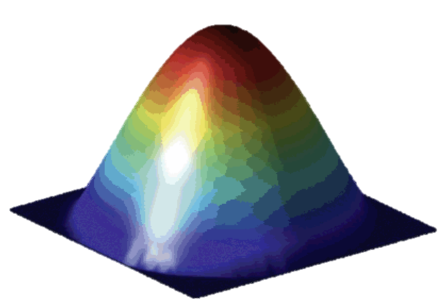
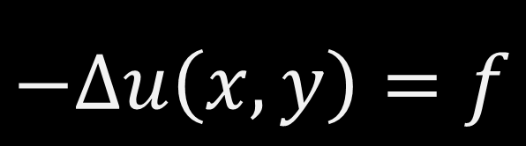
Hands On Activity #4
15 Minutes
$$−Δu\left(x,y\right)=f$$
MPI_Ineighbor_alltoallv

Slide 125
Section V
Graph Partitioning
(Using Metis)

Slide 126
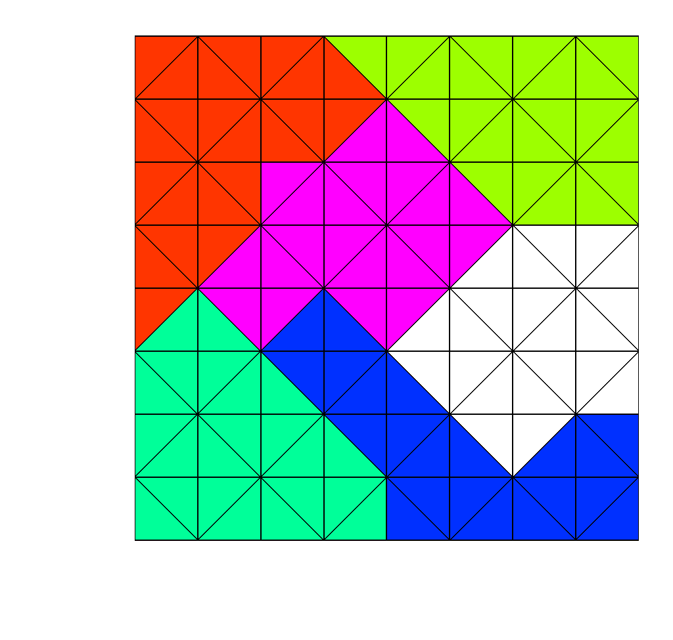
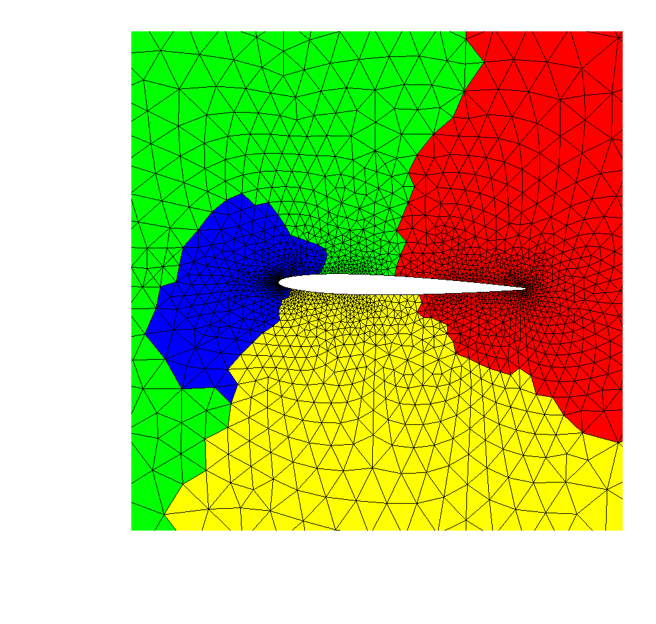
METIS / ParMETIS: Graph Partitioner
Available from the Karypis Lab University of Minnesota
http://glaros.dtc.umn.edu/gkhome/views/metis
0
1
2
3
4
5
6
7
8
9

Slide 127
METIS’ command-line and library interfaces.
Operation | Stand-alone Program | API Routine
Partition a graph | gpmetis | METIS_PartGraphRecursive METIS_PartGraphKway
Partition a mesh | mpmetis | METIS_PartMeshNodal METIS_PartMeshDual
Compute a fill-reducing ordering of a sparse matrix | ndmetis | METIS_NodeND
Convert a mesh into a graph | m2gmetis | METIS_MeshToNodal METIS_MeshToDual
Documentation
http://glaros.dtc.umn.edu/gkhome/fetch/sw/metis/manual.pdf

Slide 128
METIS: METIS_PartGraphRecursive
Partition a graph into k parts using multilevel recursive bisection.
int METIS_PartGraphRecursive(
idx_t *nvtxs,
idx_t *ncon,
idx_t *xadj,
idx_t *adjncy,
idx_t *vwgt, // NULL
idx_t *vsize, // NULL
idx_t *adjwgt, // NULL
idx_t *nparts,
real_t *tpwgts, // NULL
real_t ubvec, // NULL
idx_t *options, // NULL
idx_t *objval,
idx_t *part);
nvtxs : The number of vertices in the graph.
ncon : The number of balancing constraints. It should be at least 1 (i.e., set to 1).
xadj [nvtxs+1] : The 1st adjacency structure.
adjncy [2*nedges] : The 2nd adjacency structure.
vwgt : The weights of the vertices.
vsize : The size of the vertices for computing the total communication volume.
adjwgt : The weights of the edges.
nparts : The number of parts to partition.
tpwgts : The desired weight for each partition/constraint.
ubvec : The unbalanced load tolerance vector.
part [nvtxs] : The partition vector of the graph. Use options[METIS_OPTION_NUMBERING] for base 0 or 1.

Slide 129
METIS: METIS_PartGraphRecursive EXAMPLE
Partition a graph into k parts using multilevel recursive bisection.
xadj - size is nvts+1
adjncy - size is 2*nedges
CSR Format
xadj = [0 2 5 8 11 13 16 20 24 28 31 33 36 39 42 44] adjncy = [1 5 0 2 6 1 3 7 2 4 8 3 9 0 6 10 1 5 7 11 2 6 8 12 3 7 9 13 4 8 14 5 11 6 10 12 7 11 13 8 12 14 9 13]
0
1
2
3
4
nvtxs = 15
nedges = 22
5
6
7
8
9
10
11
12
13
14

Slide 130
METIS: METIS_PartGraphRecursive EXAMPLE
Partition a graph into k parts using multilevel recursive bisection.
xadj – stores the index
adjncy – list of node connected
xadj
0
adjncy
1 | 5
0 | 1 | 2 | 3 | 4 | 5 | 6 | 7 | 8 | 9 | 10 | 11 | 12 | 13 | 14 | 15 | 16 | 17 | 18 | 19 | 20 | 21
0
0
1
2
3
4
nvtxs = 15
nedges = 22
5
6
7
8
9
10
11
12
13
14

Slide 131
METIS: METIS_PartGraphRecursive EXAMPLE
Partition a graph into k parts using multilevel recursive bisection.
xadj – stores the index
adjncy – list of node connected
xadj
0 | 2
adjncy
1 | 5 | 0 | 2 | 6
0 | 1 | 2 | 3 | 4 | 5 | 6 | 7 | 8 | 9 | 10 | 11 | 12 | 13 | 14 | 15 | 16 | 17 | 18 | 19 | 20 | 21
0
1
2
3
4
nvtxs = 15
nedges = 22
5
6
7
8
9
10
11
12
13
14

Slide 132
METIS: METIS_PartGraphRecursive EXAMPLE
Partition a graph into k parts using multilevel recursive bisection.
xadj – stores the index
adjncy – list of node connected
xadj
0 | 2 | 5
adjncy
1 | 5 | 0 | 2 | 6 | 1 | 3 | 7
0 | 1 | 2 | 3 | 4 | 5 | 6 | 7 | 8 | 9 | 10 | 11 | 12 | 13 | 14 | 15 | 16 | 17 | 18 | 19 | 20 | 21
0
1
2
3
4
nvtxs = 15
nedges = 22
5
6
7
8
9
10
11
12
13
14

Slide 133
METIS: METIS_PartGraphRecursive EXAMPLE
Partition a graph into k parts using multilevel recursive bisection.
xadj – stores the index
adjncy – list of node connected
xadj
0 | 2 | 5 | 8
adjncy
1 | 5 | 0 | 2 | 6 | 1 | 3 | 7 | 2 | 4 | 8
0 | 1 | 2 | 3 | 4 | 5 | 6 | 7 | 8 | 9 | 10 | 11 | 12 | 13 | 14 | 15 | 16 | 17 | 18 | 19 | 20 | 21
0
1
2
3
4
nvtxs = 15
nedges = 22
5
6
7
8
9
10
11
12
13
14

Slide 134
METIS: METIS_PartGraphRecursive EXAMPLE
Partition a graph into k parts using multilevel recursive bisection.
xadj – stores the index
adjncy – list of node connected
xadj
0 | 2 | 5 | 8 | 11
adjncy
1 | 5 | 0 | 2 | 6 | 1 | 3 | 7 | 2 | 4 | 8 | 3 | 9
0 | 1 | 2 | 3 | 4 | 5 | 6 | 7 | 8 | 9 | 10 | 11 | 12 | 13 | 14 | 15 | 16 | 17 | 18 | 19 | 20 | 21
0
1
2
3
4
nvtxs = 15
nedges = 22
5
6
7
8
9
10
11
12
13
14

Slide 135
METIS: METIS_PartGraphRecursive EXAMPLE
Partition a graph into k parts using multilevel recursive bisection.
xadj – stores the index
adjncy – list of node connected
xadj
0 | 2 | 5 | 8 | 11 | 13
adjncy
1 | 5 | 0 | 2 | 6 | 1 | 3 | 7 | 2 | 4 | 8 | 3 | 9 | 0 | 6 | 10
0 | 1 | 2 | 3 | 4 | 5 | 6 | 7 | 8 | 9 | 10 | 11 | 12 | 13 | 14 | 15 | 16 | 17 | 18 | 19 | 20 | 21
0
1
2
3
4
nvtxs = 15
nedges = 22
5
6
7
8
9
10
11
12
13
14

Slide 136
METIS: METIS_PartGraphRecursive EXAMPLE
Partition a graph into k parts using multilevel recursive bisection.
xadj – stores the index
adjncy – list of node connected
xadj
0 | 2 | 5 | 8 | 11 | 13 | 16
adjncy
1 | 5 | 0 | 2 | 6 | 1 | 3 | 7 | 2 | 4 | 8 | 3 | 9 | 0 | 6 | 10 | 1 | 5 | 7 | 11
0 | 1 | 2 | 3 | 4 | 5 | 6 | 7 | 8 | 9 | 10 | 11 | 12 | 13 | 14 | 15 | 16 | 17 | 18 | 19 | 20 | 21
0
1
2
3
4
nvtxs = 15
nedges = 22
5
6
7
8
9
10
11
12
13
14

Slide 137
METIS: METIS_PartGraphRecursive EXAMPLE
Partition a graph into k parts using multilevel recursive bisection.
xadj – stores the index
adjncy – list of node connected
xadj
0 | 2 | 5 | 8 | 11 | 13 | 16 | …
adjncy
1 | 5 | 0 | 2 | 6 | 1 | 3 | 7 | 2 | 4 | 8 | 3 | 9 | 0 | 6 | 10 | 5 | 7 | 1 | 11 | …
0 | 1 | 2 | 3 | 4 | 5 | 6 | 7 | 8 | 9 | 10 | 11 | 12 | 13 | 14 | 15 | 16 | 17 | 18 | 19 | 20 | 21
0
1
2
3
4
nvtxs = 15
nedges = 22
5
6
7
8
9
10
11
12
13
14

Slide 138
METIS: METIS_PartMeshDual
Partition mesh into k parts based on a partitioning of the mesh’s dual graph.
int METIS_PartMeshDual (
idx_t *ne,
idx_t *nn,
idx_t *eptr,
idx_t *adjncy,
idx_t *vwgt, // NULL
idx_t *vsize, // NULL
idx_t ncommon,
idx_t *nparts,
idx_t *adjwgt, // NULL
idx_t *options, // NULL
idx_t *objval,
idx_t *epart,
idx_t *npart);
Mesh
Dual Mesh
Centroids

Slide 139
METIS: METIS_PartMeshDual
Partition mesh into k parts based on a partitioning of the mesh’s dual graph.
int METIS_PartMeshDual (
idx_t *ne,
idx_t *nn,
idx_t *eptr,
idx_t *adjncy,
idx_t *vwgt, // NULL
idx_t *vsize, // NULL
idx_t ncommon,
idx_t *nparts,
idx_t *adjwgt, // NULL
idx_t *options, // NULL
idx_t *objval,
idx_t *epart,
idx_t *npart);
ne : The number of elements in mesh.
nn : The number nodes is mesh.
eptr : The 1st mesh array structure.
eind : The 2nd mesh array structure.
vwgt : The weights of the elements.
vsize : The size of the elements for computing the total communication volume.
ncommon : Number of nodes to make element face.
nparts : The number of parts to partition.
adjwgt : The weights of the edges.
epart [ne] : The partition vector of the elements.
npart [nn] : The partition vector of the nodes.

Slide 140
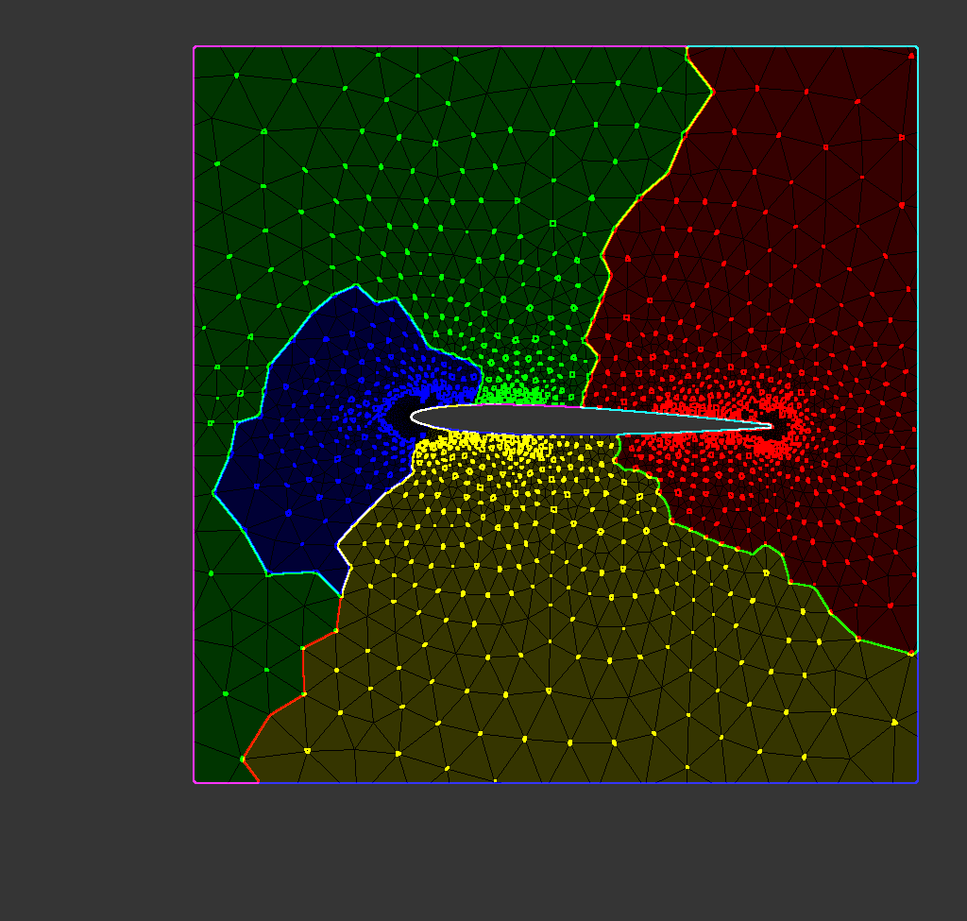
Hands On Activity #5
METIS_PartMeshDual

Slide 141
FINAL TAKEAWAYS
What we learned:
MPI Derived Datatypes and Custom Operations
MPI Virtual Topologies
MPI Neighborhood Collectives
Graph Partitioning

